Slide 1
Data from APIs and Feeds
Grace Lang
Section 407

Slide 2
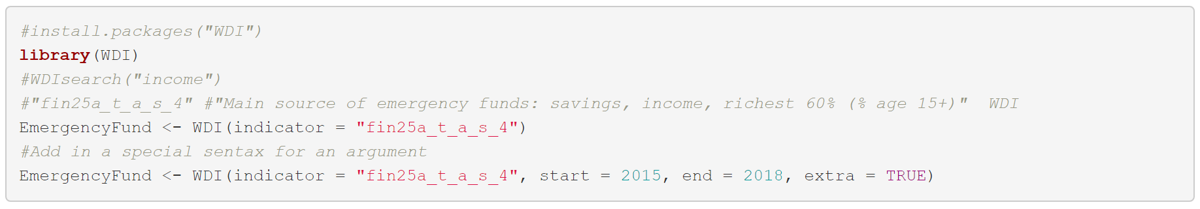
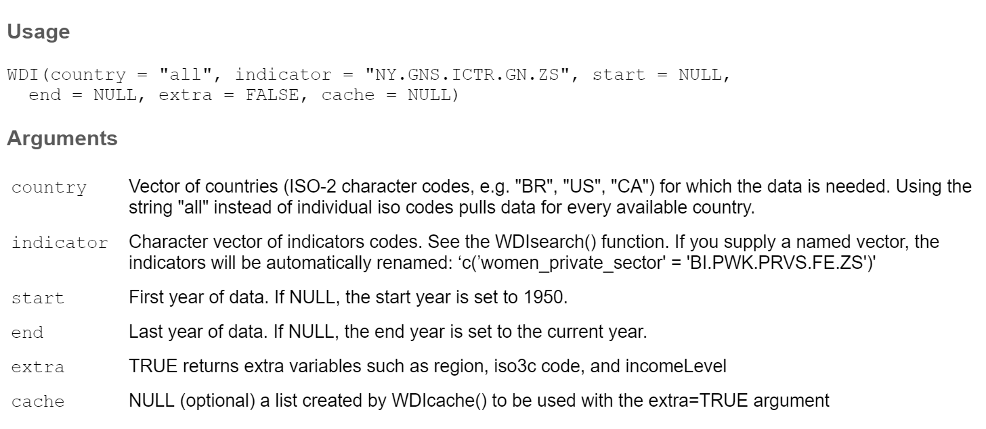
WDI Package: search “income”
?WDI() HELP

Slide 3
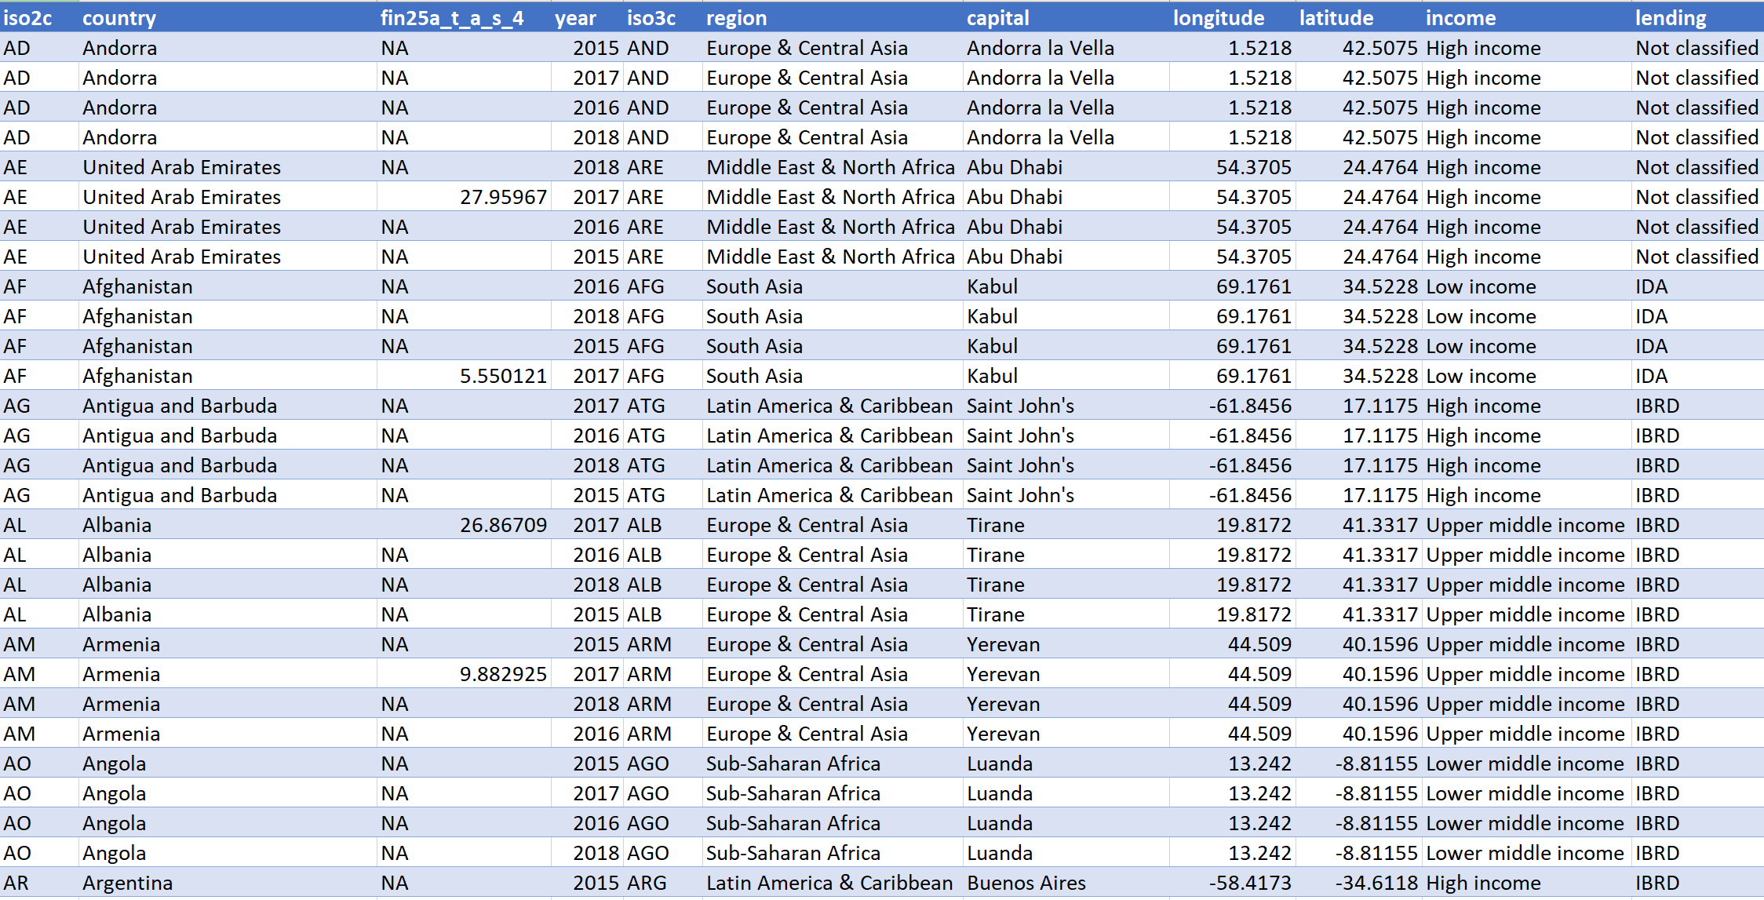
Main source of emergency funds: savings, income, richest 60% (% age 15+)
Data source: WDI, author Vincent Arel-Bundock

Slide 4
Next Steps
Research data collection methodology
Understand definitions of the following fields:
Fin25a_t_a_s_4
Iso3c
Income: (What are the bucketing thresholds?)
Lending
Is there any complementary data to support table?

Slide 5
Takeaways
Leverage ?() help sections when possible
Filtering data pull within argument section can save time mining data later
Cross-compare data to ‘real-world’ interpretations if available

